Slide 1
Fuzzy-Token: An Adaptive MAC Protocol for Wireless-Enabled Manycores
Antonio Franques¹ (franque2@illinois.edu),
Sergi Abadal², Haitham Hassanieh¹, Josep Torrellas¹
¹University of Illinois at Urbana-Champaign
² Universitat Politècnica de Catalunya
CCF-1629431
863337 (WiPLASH)
Notes:
Hello, my name is Antonio Franques and today I will be presenting Fuzzy Token: an adaptive mac protocol for wireless-enabled manycores. This work has ben done in collaboration with my colleagues at the university of Illinois at urbana-champaign and universitat politecnica de catalunya

Slide 2
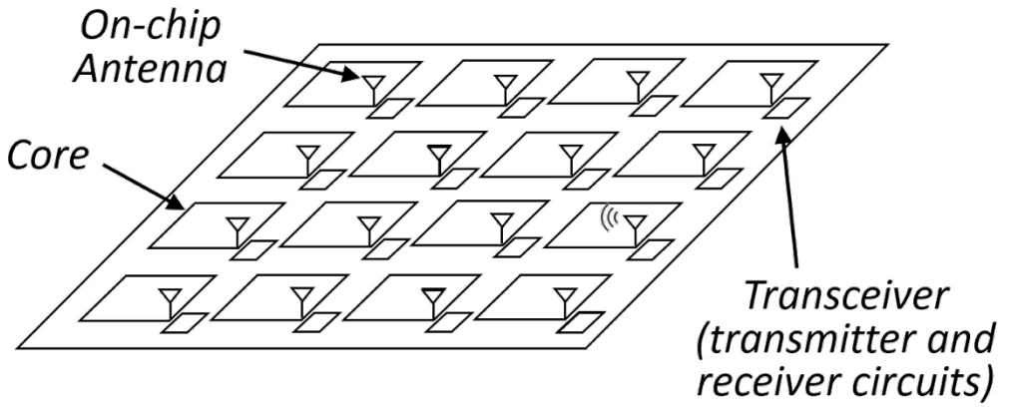
Context
Current trends are leading to larger manycores
Wireless on-chip communication holds promise for the implementation of fast networks for these multiprocessors
In complement of a wired NoC, wireless provides
Low latency
Natural broadcast capabilities
Flexibility
Notes:
The context of this work arises from the fact that current semiconductor trends are leading to larger manycores.
Wireless on chip communication holds promise for the implementation of fast networks for these multiprocessors due to the fact that when used in complement of a wired NoC, wireless can provide a low-latency, broadcast-friendly, and flexible environment to send data across the chip

Slide 3
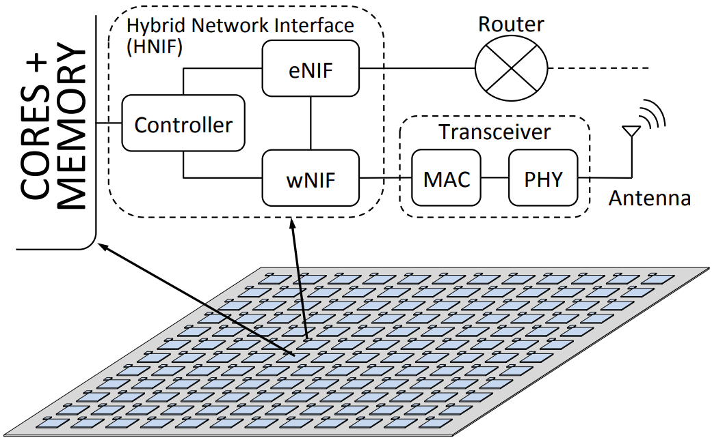
Wired+Wireless Network-on-Chip
Notes:
The high-level diagram of a hybrid wired and wireless network on chip is shown in this picture. In this design, every core in the chip is augmented with an antenna and transceiver.
The hybrid network interface is in charge of choosing whether a packet is sent through the wired electrical router and mesh, or through the wireless transceiver and antenna

Slide 4
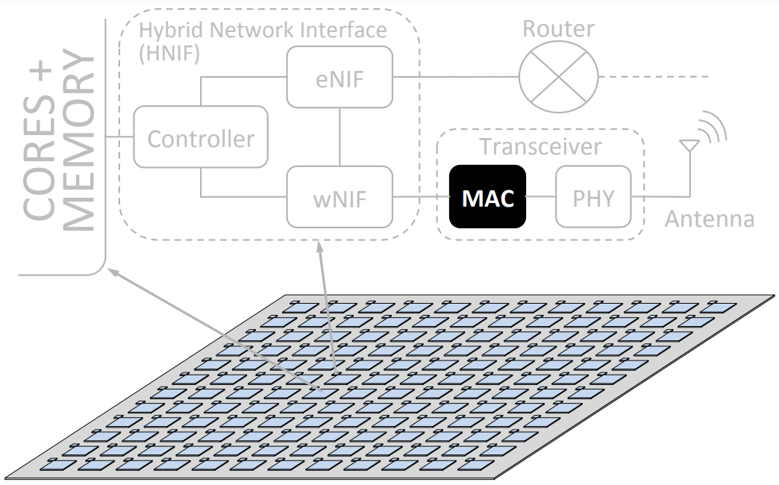
Wired+Wireless Network-on-Chip
Notes:
More specifically, the wireless transceiver contains the Medium Access Control (or MAC) module, which is the focus of this work

Slide 5
Motivation
As the core density increases, more wireless interfaces can be expected on chip
Need for arbitration strategies (MAC protocols)
That provide low access latency
That scale with number of wireless nodes
That adapt to different traffic patterns
That are simple to implement
Notes:
The motivation behind our work is based on the premise that as the core density increases and more wireless interfaces are expected on chips, we need wireless arbitration strategies (also known as MAC protocols) that… [mention list]

Slide 6
Medium Access Control (MAC)
The MAC layer defines mechanisms to ensure that all nodes can access the shared wireless medium in an organized manner
Two common access methods: token passing, random access
Token passing | Random access
Pass a token around a virtual ring. Only the token holder can transmit | Simultaneous accesses to the same channel collide and need to retry
Core 1
Core 2
Core 3
✓
Core 1
Core 2
Core 3
×
✓
t
t
t
t
✓
t
×
✓
t
Notes:
This MAC module, which is in charge of ensuring that all nodes can access the shared wireless medium in an organized manner, can use different strategies. Two common access methods in both off-chip and on-chip scenarios are token passing and random access. With token passing we pass a conceptual token around a virtual ring at each period, and only the token holder can transmit at any given time.
As we see on the left example, only core1 (who is the one holding the token in the first period) can transmit. In the second period Core2 holds the token, however this one doesn’t have anything to transmit and therefore the period is wasted. Finally, in the third period Core3 holds the token and therefore is able to send its data.
On the other hand, with random access, nodes can attempt to transmit at any time, however simultaneous attempts collide and need to retry later (using a random backoff period). As we see on the right example, core1 and core3 detect that the wireless medium is free in the first period, and therefore both attempt to transmit at the same time, this leads to a collision, and thus both cores retry later (core1 in the 2nd period, and core3 in the 3rd)
This simple example depicts the case in which Core1 and Core3 have data to transmit.
With token passing, as we see on the left, only core1 (who is the one holding the token in the first period) can transmit. In the second period Core2 holds the token, however this one doesn’t have anything to transmit and therefore the period is wasted. Finally, in the third period Core3 holds the token and therefore is able to send its data.
Alternatively, with random access, as we see on the right, core1 and core3 detect that the wireless medium is free in the first period, and therefore both attempt to transmit at the same time, this leads to a collision, and thus both cores retry later (core1 in the 2nd period, and core3 in the 3rd)

Slide 7
Medium Access Control (MAC)
No wasted cycles at high loads
Unnecessary delays if contention is low
No wasted cycles if contention is low (transmit right away)
Lots of collisions at high loads
The MAC layer defines mechanisms to ensure that all nodes can access the shared wireless medium in a reliable manner
Two common access methods: token passing, random access
Token passing | Random access
Pass a token around a virtual ring. Only the token holder can transmit | Simultaneous accesses to the same channel collide and need to retry
Core 1
Core 2
Core 3
✓
Core 1
Core 2
Core 3
×
✓
t
t
t
t
✓
t
×
✓
t
Notes:
Summarizing, we observe that although token passing works very well at high loads, since it avoids starvation and wasted cycles, it leads to unnecessary delays when contention is low.
On the other hand, random access avoids these delays when contention is low (since nodes can attempt to transmit right away as opposed to waiting to hold the token), but suffers lots of collisions at high loads (since many nodes attempt to transmit at the same time)

Slide 8
MAC Context Analysis
Wireless on-chip scenario
Physically constrained – need for lightweight MAC protocol
Unlike off-chip scenarios, the environment is static and known beforehand
All nodes are synchronized
Collisions can always be detected
Protocols must scale to many cores and adapt to changes in traffic
 | Low load | High load | Variability
Random access | ✓ | ✗ | ✗
Token passing | ✗ | ✓ | ✗
??? | ✓ | ✓ | ✓
Notes:
Another key aspect to consider in this MAC context analysis is that when we target the on-chip scenario, circuitry space is very limited, and therefore the chosen MAC protocol must be lightweight and easy to implement.
An advantage of this on-chip scenario though is the fact that unlike off-chip, the environment is static and known beforehand, which allows all nodes to be synchronized without the need to exchange explicit messages, and also that collisions can always be detected, thus avoiding the hidden terminal problem of off-chip networks.
Now, the question is: if a pure random access protocol works very well at low loads but poorly at high loads, and a pure token passing protocol works very well at high loads and poorly at low loads, how can we have a protocol that works well in both scenarios, that is suited for the on-chip scenario, that scales to many cores, and that at the same time can adapt to changes in traffic?

Slide 9
Contribution: Fuzzy-Token
We propose Fuzzy-Token, a hybrid protocol based on two basic approaches: token passing, and random access
We evaluate the performance of Fuzzy-Token with a synthetic traffic suite and real application traces
We compare the obtained performance with that of a token-passing and a random-access protocol for wireless NoCs, called BRS (Mestres et al, 2016)
Notes:
Our answer to that question is fuzzy-token. Fuzzy token is a hybrid protocol based on the 2 aforementioned basic approaches, namely token passing and random access.
We evaluate the performance of fuzzy token with a synthetic traffic suite and real application traces.
We compared the obtained peformance with that of a token passing and a random access protocol for wireless NoCs called BRS

Slide 10
Fuzzy-Token: Main Idea (1/2)
2 operation modes
Focused → only the token holder can transmit (collision-free guarantee)
Fuzzy → all nodes inside Fuzzy Area (except token holder) that have pending packets can transmit with probability p_{i}
Mode can change at each step
If in focused and token holder doesn’t transmit → switch to fuzzy
If in fuzzy and collision → switch to focused
Notes:
The main idea behind fuzzy-token is to have 2 operation modes. In the 1st mode, named focused, only the token holder can transmit and therefore we guarantee a collision-free transmission.
In the 2nd mode, named fuzzy, all nodes inside the so called fuzzy area (with the exception of the token holder) may transmit with a certain probability.
We may switch between modes at each step. For example, if we are in focused mode and the token holder doesn't transmit we switch to fuzzy mode. Alternatively, if we are in fuzzy mode and we detect a collision we switch to focused mode.

Slide 11
Fuzzy-Token: Main Idea (2/2)
Fuzzy Area size controls amount of contention at each step
Increase size (after idle step) when the load is low to give rapid access to the few nodes that want to transmit
Quickly decrease size (after collision) when load increases to minimize further collisions
Notes:
The fuzzy area and its size is what allows us to control the amount of contention at each step. We increase the size of the fuzzy area after an idle step when the load is low so that we can give rapid access to the few nodes that want to transmit.
Also we quickly decrease the size of the fuzzy area after a collision when the load increases so that we can minimize further collisions

Slide 12
Fuzzy-Token: Example (1/2)
Initial state
Fuzzy Mode (all nodes inside Fuzzy Area except token holder may transmit)
Token holder: node 0, Fuzzy Area size: 5
Fuzzy Area size updated using additive increase multiplicative decrease
Increase area size by 1 after each idle step
Decrease area size by half (round up) after a collision
Notes:
We illustrate the idea behind Fuzzy-Token with the following example. Although nodes in the chip can be physically arranged as the manufacturer considers it opportune, in this example all nodes in the chip have been logically organized as a ring in order to make it more intuitive.
Also, in this example, white nodes are idle (meaning they do not have data to transmit), the red node is the token holder at each step, yellow nodes are the ones that have data pending to be transmitted, and the blue lightning indicates a node is transmitting.
The initial state consists of the protocol being in fuzzy mode (meaning that all nodes inside the fuzzy area except the token holder may transmit), and with a fuzzy area of 5 (meaning only the 2 nodes at each side of the token holder may attempt to transmit).
The chosen policy to update the fuzzy area size is additive increase multiplicative decrease, which means that the area is increased by 1 after each idle step, and decreased by half after a collision.

Slide 13
Fuzzy-Token: Example (1/2)
Initial state
Fuzzy Mode (all nodes inside Fuzzy Area except token holder may transmit)
Token holder: node 0, Fuzzy Area size: 5
Fuzzy Area size updated using additive increase multiplicative decrease
Increase area size by 1 after each idle step
Decrease area size by half (round up) after a collision
Notes:
So, firstly, in step B, we are in fuzzy mode, and therefore all the ready nodes inside the fuzzy area (which are 2 and 11), with the exception of the token holder, may attempt to transmit, but because they do it with different probability, only node 11 actually attempts to transmit, which it does successfully.
Next, in step C, because a packet was transmitted successfully, we remain in fuzzy mode, the fuzzy area size remains to be 5, and as always the token is implicitly passed to the next node (in this case from node0 to node1). With this, the fuzzy area also pivoted around the token holder and therefore now includes node3 but excludes node10.
In this step we see nodes 2 and 3 attempting to transmit at the same time, which leads to a collision, to the fuzzy area size decreased by half, and a switch to focused mode. Regardless of this, the token is passed to the next node, as always.
Now, because in step D we are in focused mode (meaning the token holder is the only one allowed to transmit), and because the actual token holder in this step (node 2) has data ready to transmit, it does so without anyone else interrupting (even if node 3 was also ready).
Next, in Step E, we implicitly pass the token to node 3, and since we successfully transmitted a packet in focused mode we remain in this mode, which allows the token holder (node 3) to also successfully transmit the data it had ready.

Slide 14
Fuzzy-Token: Example (2/2)
Initial state
Fuzzy Mode (all nodes inside Fuzzy Area except token holder may transmit)
Token holder: node 0, Fuzzy Area size: 5
Fuzzy Area size updated using additive increase multiplicative decrease
Increase area size by 1 after each idle step
Decrease area size by half (round up) after a collision
Notes:
As we left it in step E, because of the successful transmission of the token holder (node 3), we move to step F remaining in focused mode, simply passing the token and pivoting the fuzzy area. However, because in this step the token holder does not have any data to transmit we switch to fuzzy mode and increase the fuzzy area by 1.
As shown in step G, this is not enough to let the only ready node into the party, and therefore this idle step leads to another increase in the fuzzy area. Finally, in step H, the last ready node enters the fuzzy area, and because we remained in fuzzy mode and there was no other ready nodes attempting to transmit, it does so successfully.

Slide 15
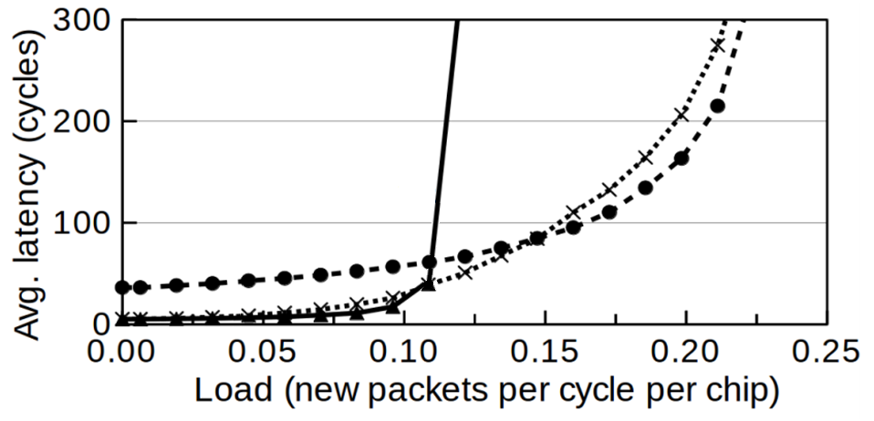
Fuzzy-Token: Evaluation (1/2)
Synthetic traffic latency
As good as BRS at low loads (fully open Fuzzy Area, transmit immediately)
Almost as good as Token at high loads (very small Fuzzy Area, mostly Token Holder is the only one that can transmit)
Dynamic and fast adaptation from one behavior to another as load changes
Notes:
Our evaluation through a synthetic traffic suite shows that fuzzy token has a latency as good as brs at low loads (with a fully open fuzzy area that allows nodes to transmit immediately), and almost as good as token at high loads (where the fuzzy area size is close to 1, and the token holder is mostly the only one allowed to transmit).
This proves the dynamic and fast adaptation that fuzzy-token shows from one behavior to another as the load changes

Slide 16
Fuzzy-Token: Evaluation (2/2)
Real applications
We obtain latency statistics from Multi2Sim on a 64-core chip
Benchmarks from PARSEC and CRONO suites
Fuzzy-Token provides latency among the lowest of 3 protocols
4.4x lower latency than BRS, and 2.6x lower than Token
Notes:
By using a set of real applications from the PARSEC and CRONO benchmark suites on a 64-core chip with the Multi2Sim simulator, we also obtained latency statistics that shows how fuzzy-token provides a latency among the lowest of the 3 evaluated protocols.
On average, the packet latency in fuzzy-token is 4.4 times lower than a state-of-the art contention-based wireless NoC MAC protocol such as BRS, and 2.6 times lower than in a token-passing protocol.

Slide 17
Fuzzy-Token: Also in the Paper…
Design decisions
Related work
Further analysis on…
Tail latency
Hotspot traffic
Bursty traffic
Throughput
Energy consumption
Notes:
Please refer to the paper for more details on the design decisions behind the fuzzy-token protocol, a list of related work, as well as a further analysis on…

Slide 18
Fuzzy-Token: Conclusions
Thank you!
Hybrid approach combines pros of both token-passing and random-access protocols
Low latency at low loads (random-access mode)
Low latency and collision-free at high loads (token-passing mode)
Run both random-access and token-passing methods simultaneously
Token is always passed to ensure fairness among nodes
Protocol reacts immediately after traffic changes (mode change + Fuzzy Area update)
All transceivers see same consistent view of wireless channel
All nodes are synchronized and proceed in lockstep (no need for explicit messages)
Evaluation with a synthetic traffic model and real application traces shows Fuzzy-Token achieves lowest latency than baseline protocols in many different scenarios
Low/High loads
Hotspot/Bursty traffic
Notes:
To conclude this presentation and to summarize, we proposed a novel wireless MAC protocol suited for the on-chip scenario, called fuzzy-token. Fuzzy-token takes a hybrid approach that combines the advantages of both token passing and random access protocols by running both methods simultaneously.
This is possible because of the consistent view of the wireless channel, which allows all nodes to be synchronized without the need of explicit control message exchanges.
We evaluated fuzzy-token with a synthetic traffic suite and real application traces to show that it achieves the lowest latency among the evaluated protocols regardless of whether the load is low or high, or if the traffic is bursty and or shows hotspots.
Thank you for your attention and please do not hesitate to post any questions.

